Slide 1
Loan Data Presentation
Rahul Jena

Slide 2
I’ve Performed
Handling Missing Values: This step involves identifying columns with missing values, calculating the percentage of missing values, and dropping columns with more than 50% missing values. For numerical columns, missing values are imputed with the median, and for categorical columns, missing values are imputed with the mode.
Handling Duplicate Records: Duplicate records are removed from the dataset to ensure data integrity.
Handling Inconsistent Data: Categorical columns are converted to lowercase to address any inconsistencies in the data.

Slide 3
Handling Outliers: Numerical columns are analyzed for outliers, and data points beyond 3 standard deviations from the mean are removed.
Handling Data Format Issues: The 'issue_d' column is converted to datetime format, and the 'term' column is converted to numeric format.
Removing Unnecessary Columns: Columns that are not relevant to the analysis, such as 'desc' and 'url', are dropped from the dataset.
Renaming Columns: Columns are renamed to have more meaningful names. For example, 'addr_state' is renamed to 'state', and 'loan_amnt' is renamed to 'loan_amount'.
Checking Data Integrity: No specific code is provided, but it is recommended to perform further validation checks to ensure the data's integrity.

Slide 4
Visualizations: Several visualizations are created to provide insights into the loan data. These include:
Pie chart showing the distribution of loan statuses.
Box plot comparing the loan amount distribution for fully paid and charged off loans.
Histogram displaying the distribution of interest rates.
Box plot comparing the annual income distribution for different loan grades.
Histogram showing the distribution of loan terms.

Slide 5
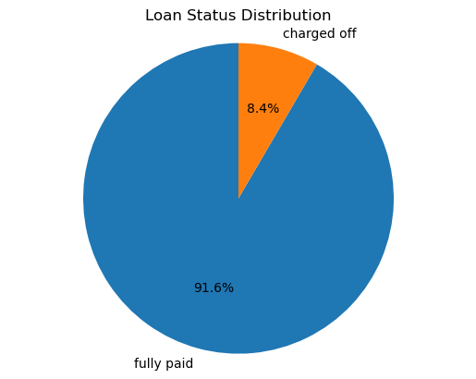
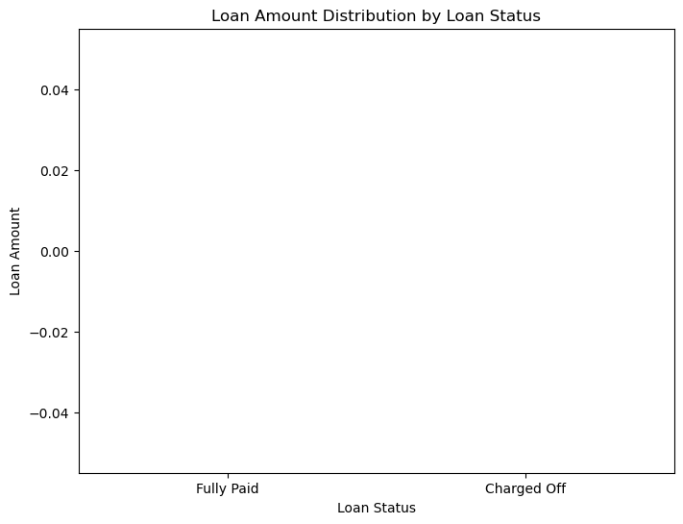
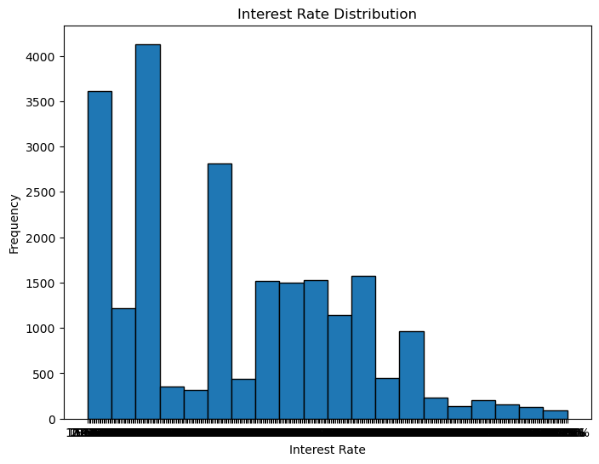
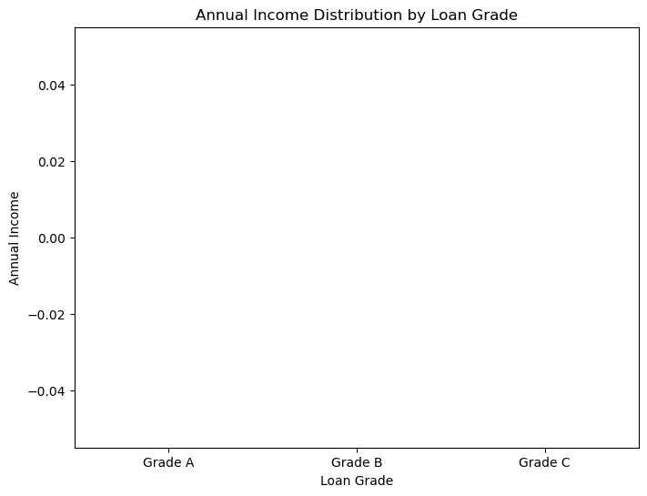
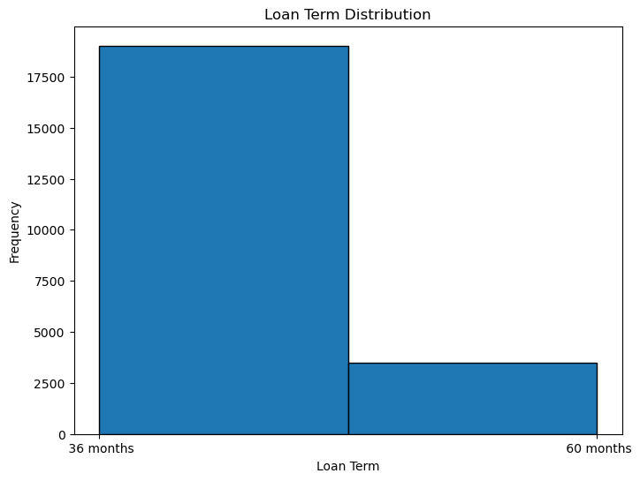

Slide 6
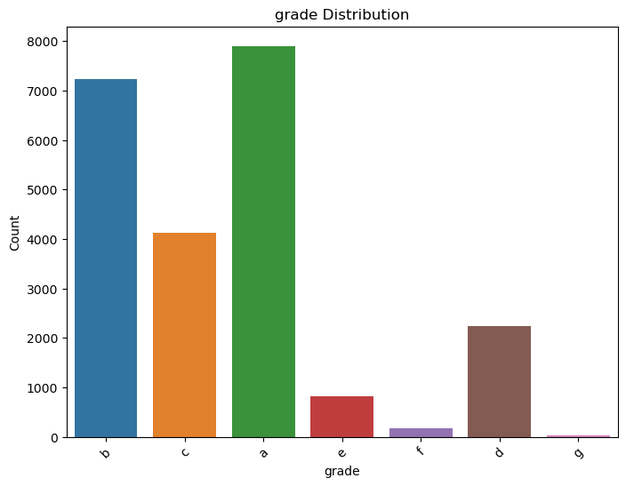
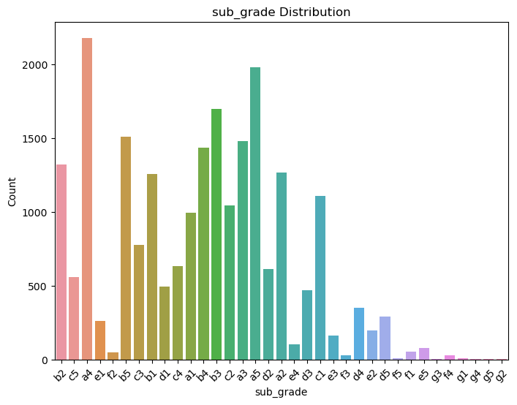
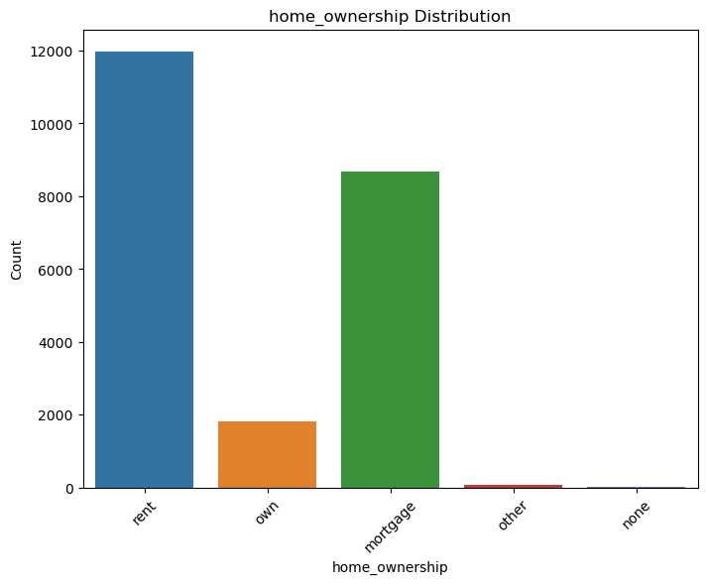
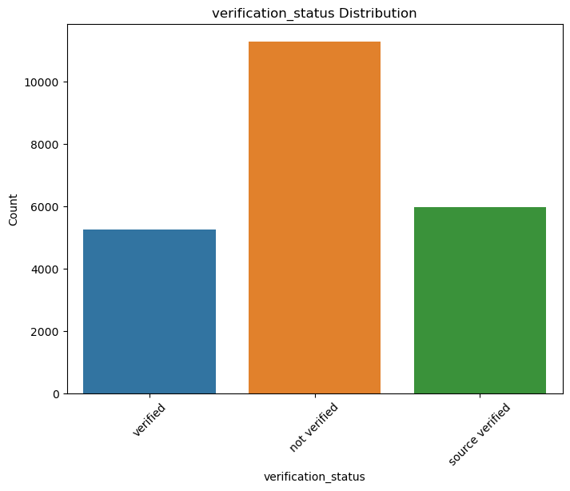
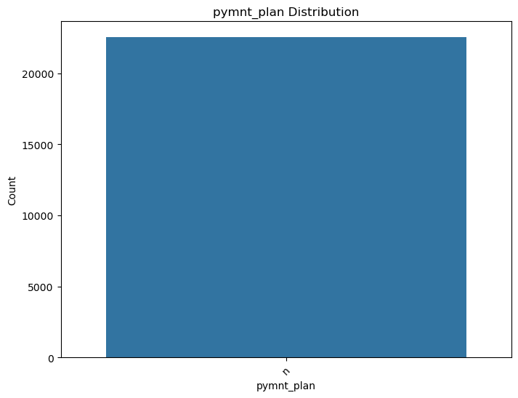
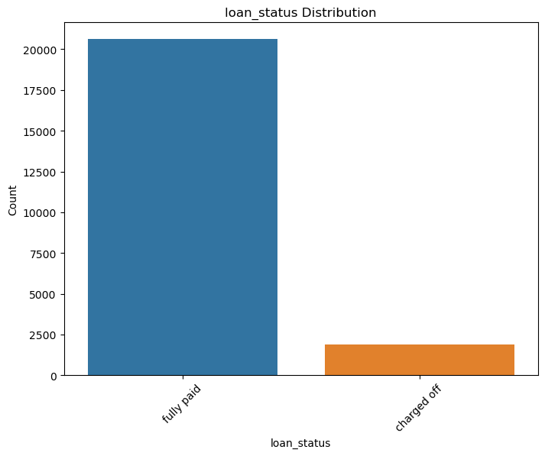
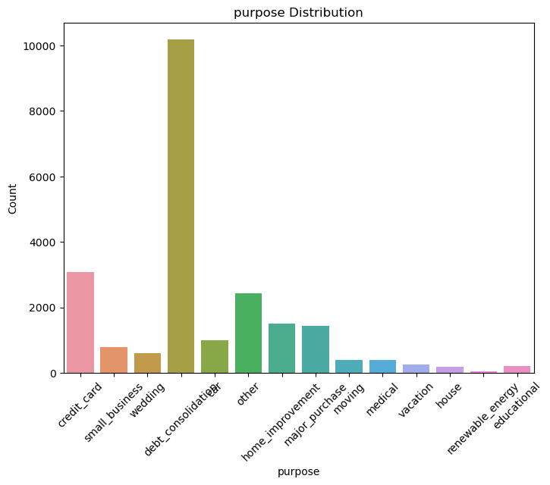
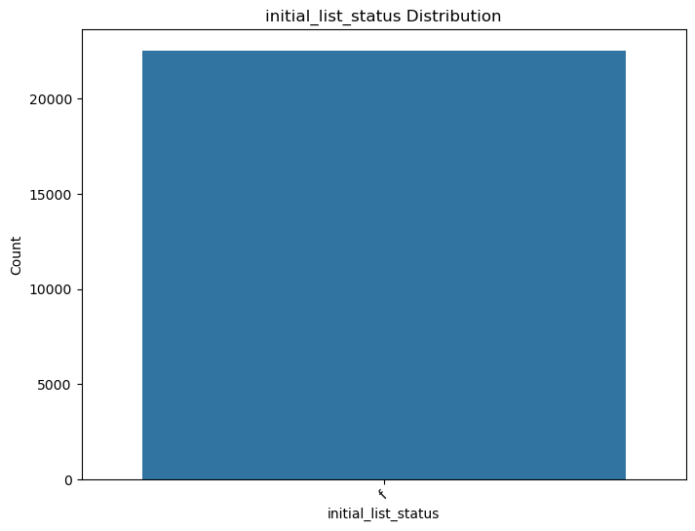
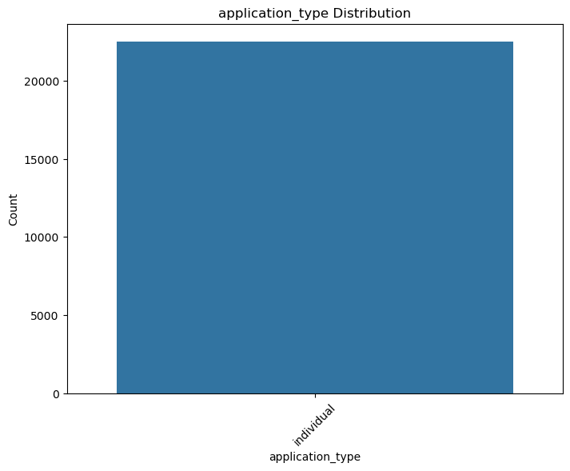
Univariate Analysis : Categorical Unprdered Variables

Slide 7
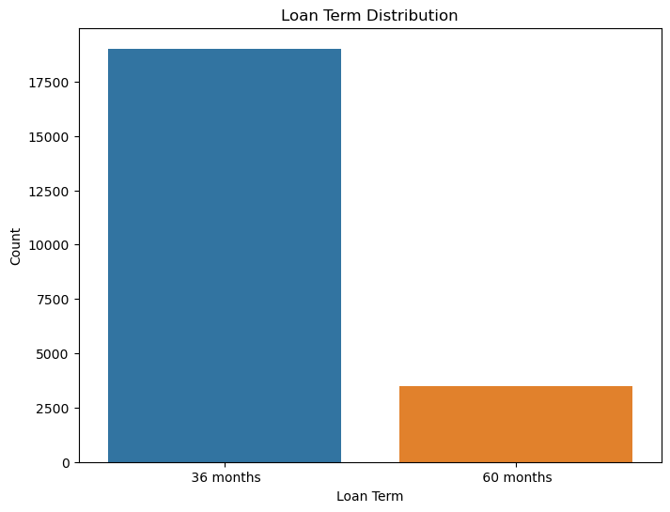
Univariate : Categorical Ordered Variable

Slide 8
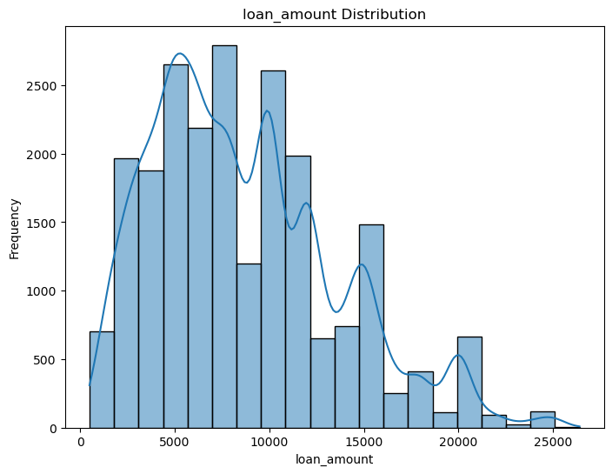
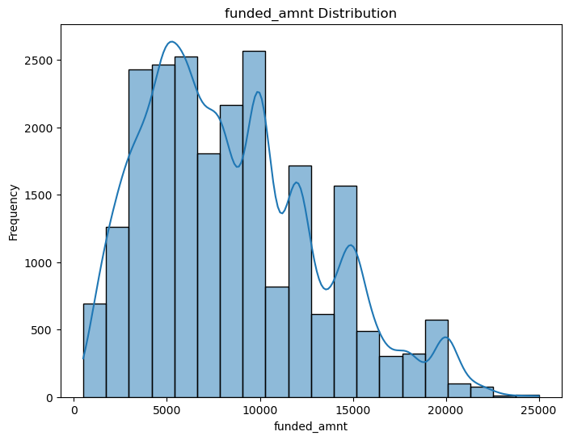
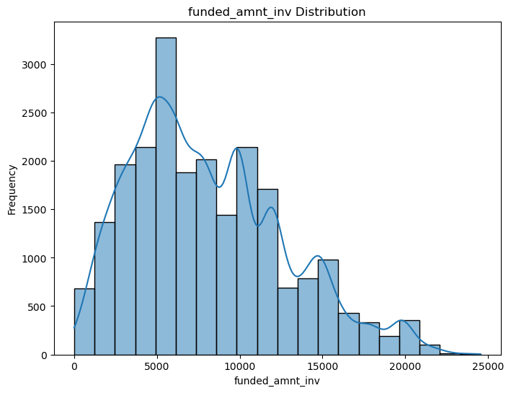
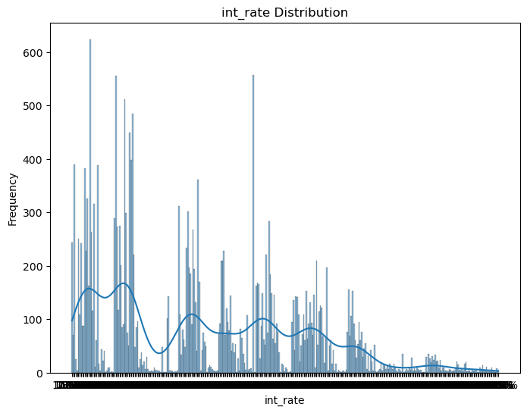
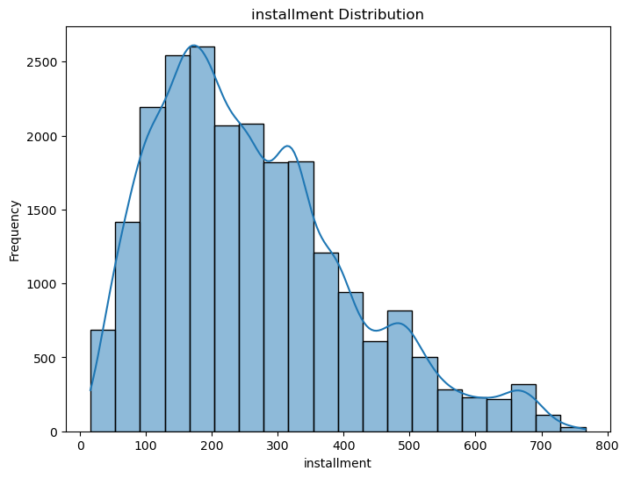
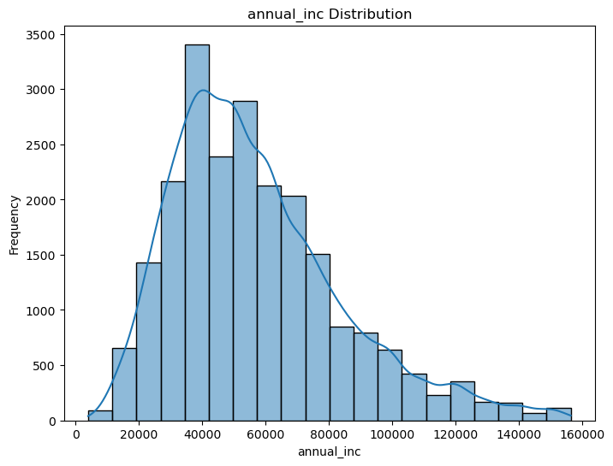
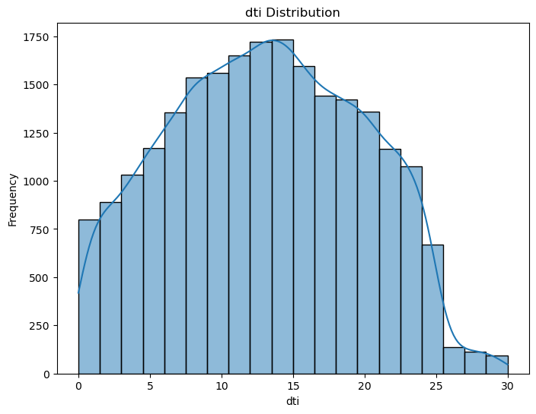
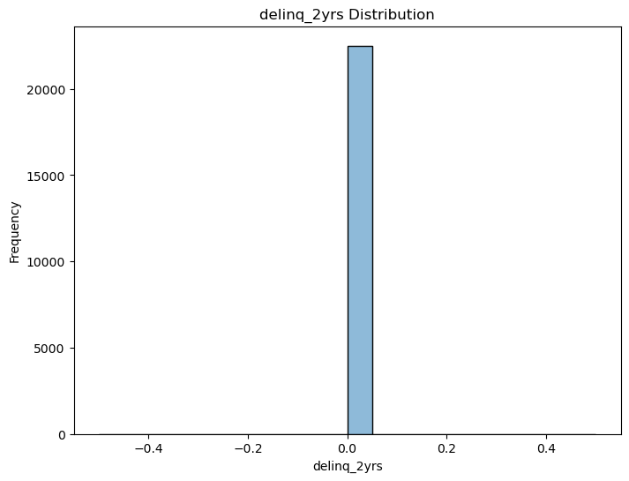
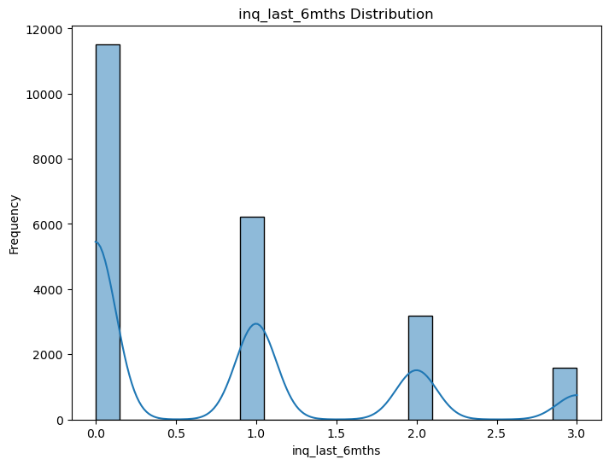
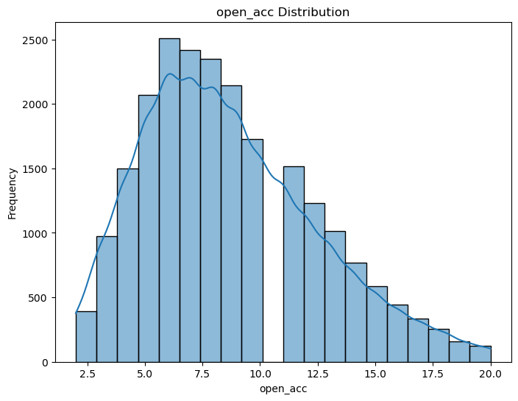
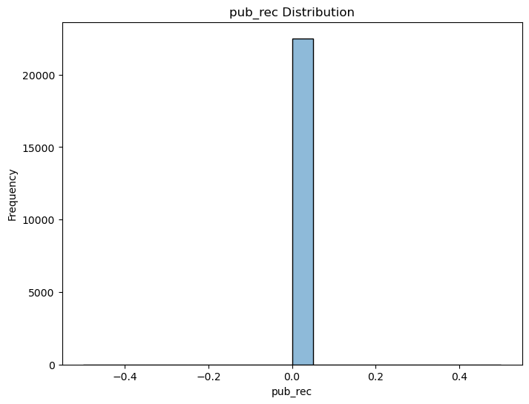
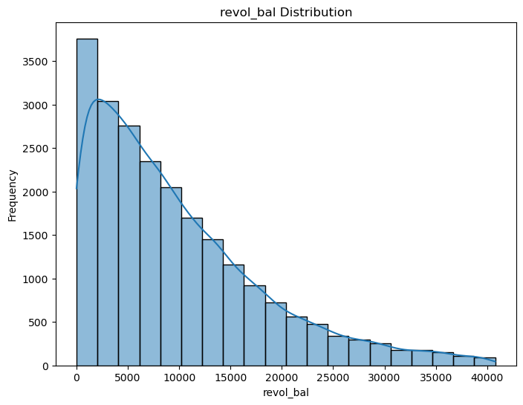
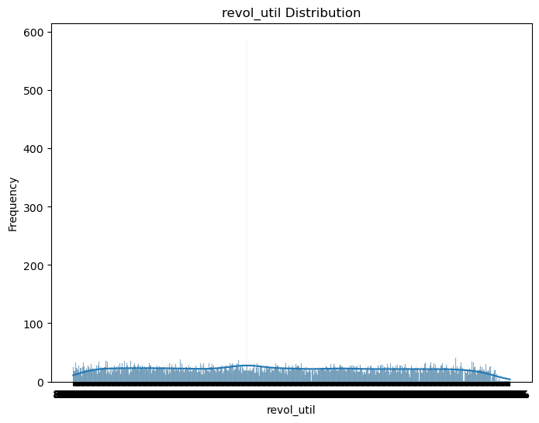
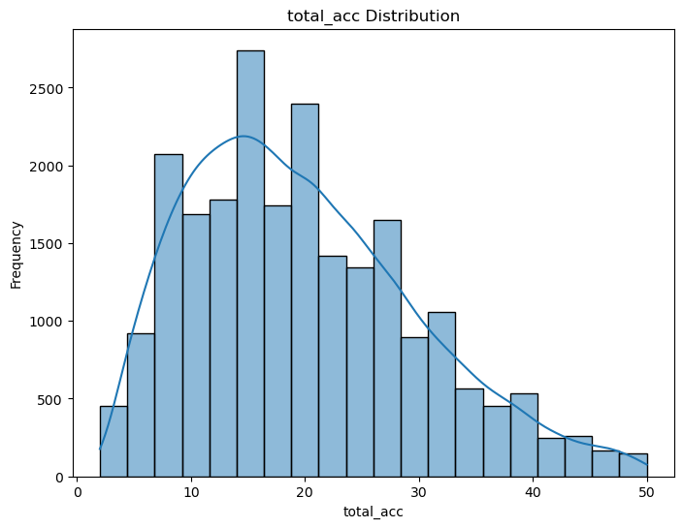
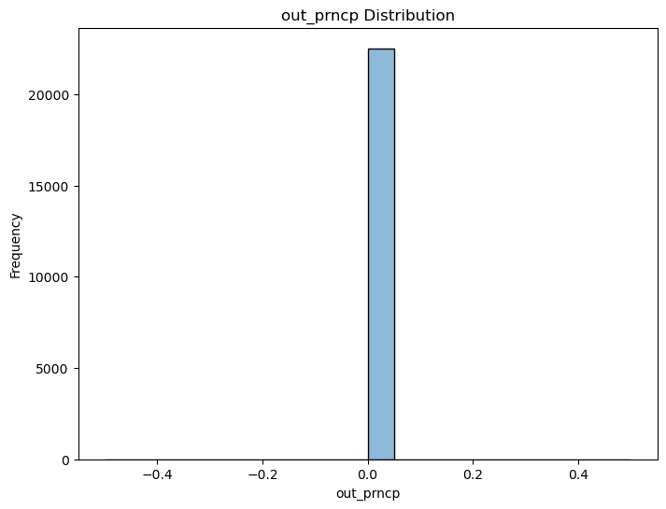
Univariate : Numerical Features

Slide 9
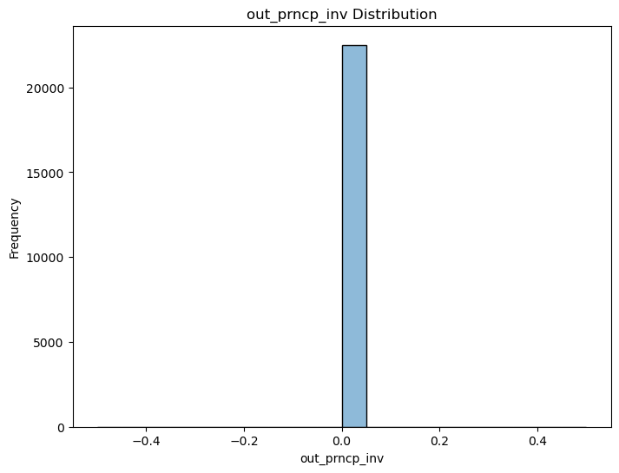
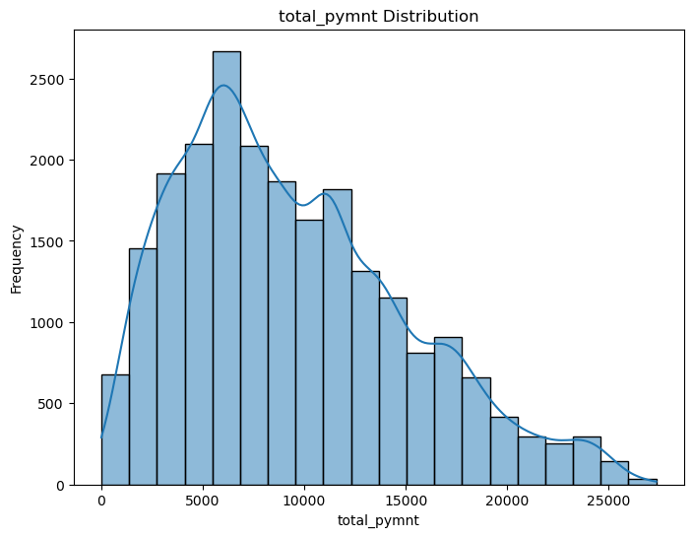

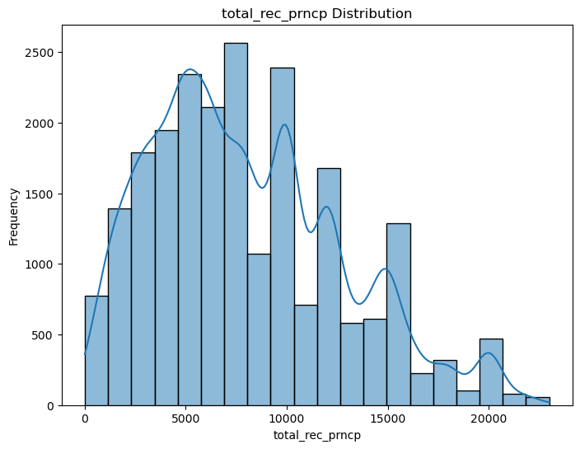
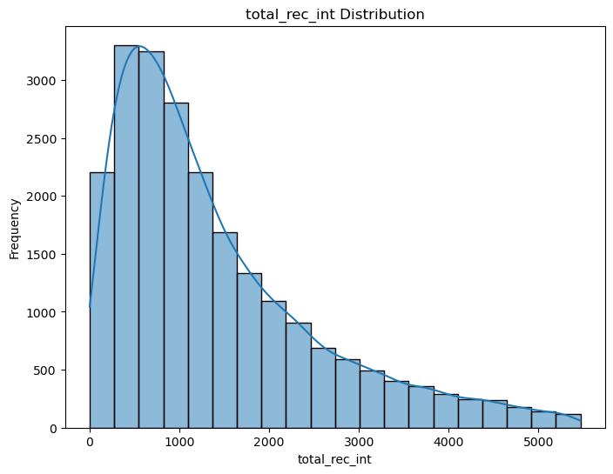
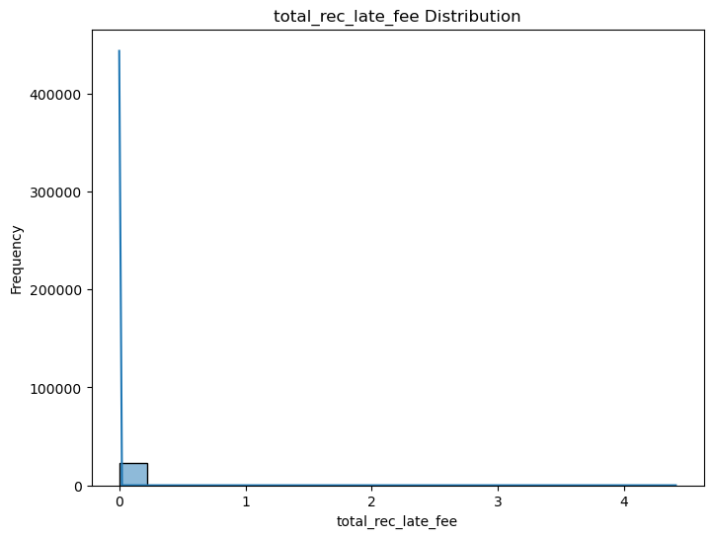
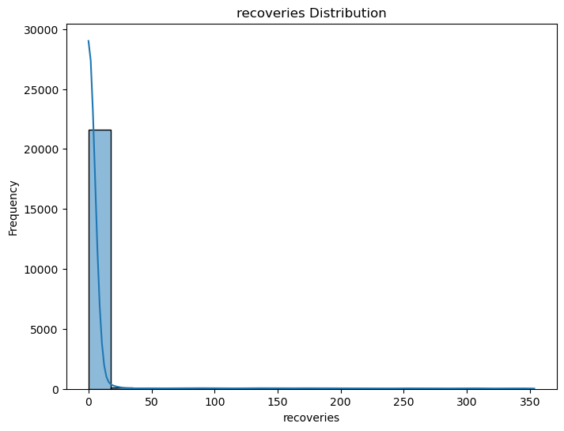
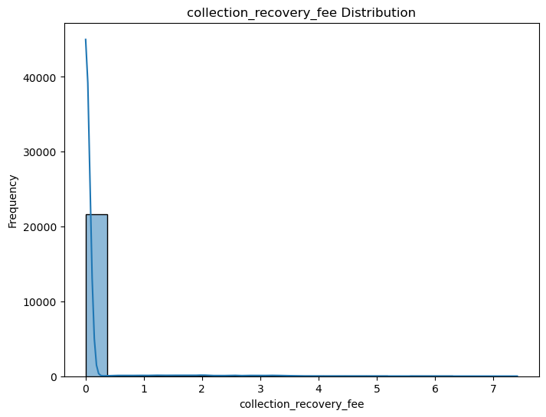

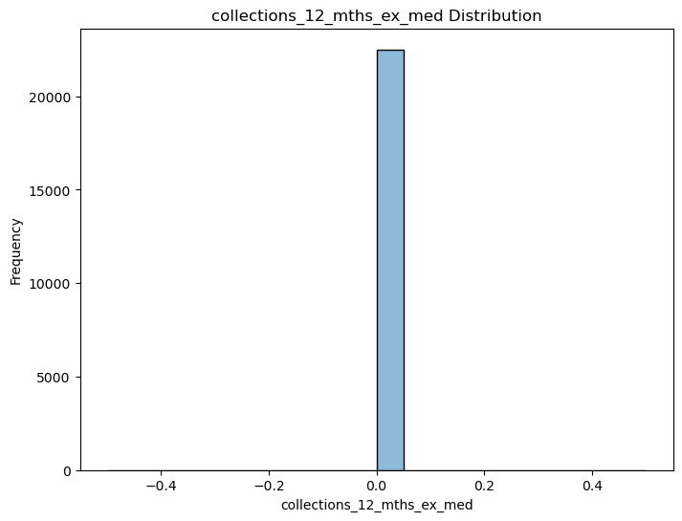

Slide 10
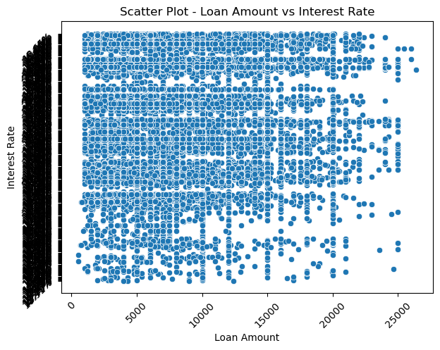
Multivariate Analysis: Numeric-Numeric Analysis

Slide 11
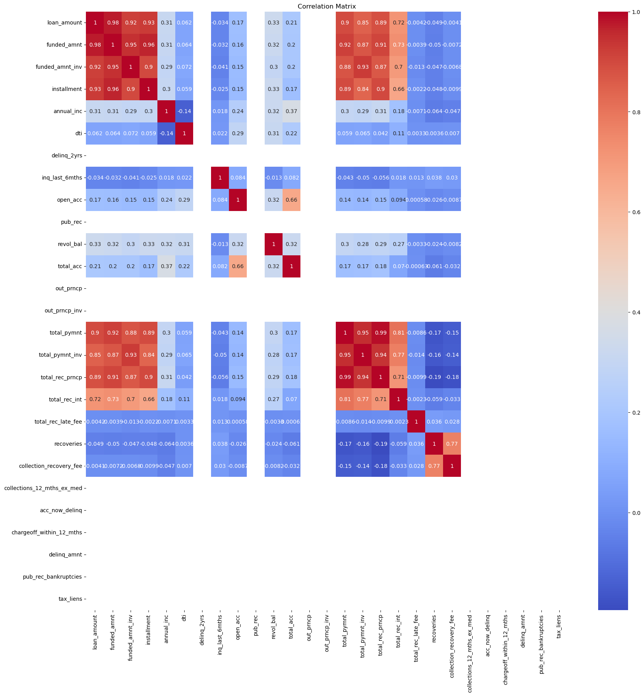
Correlation Matrix

Slide 12

Pair Plot

Slide 13
Thank You

